Slide 1

Web Application Development
COMP-229
Fall 2023

Slide 2
REACT FORMS
Forms play an essential role in modern web applications. They enable users to share information, complete tasks and provide feedback.
Without forms, many of the tasks that we take for granted on the web, such as logging in, signing up, or making purchases, would not be possible.
As such, learning how to create effective and user-friendly forms is essential for developers looking to build engaging and interactive web applications.
With its extensive collection of built-in hooks, React provides several features and techniques for creating and managing forms, including state management, event handling, and form validation.

Slide 3
In React, there are two ways of handling form data:
Controlled Components: In this approach, form data is handled by React through the use of hooks such as the useState hook.
Uncontrolled Components: Form data is handled by the Document Object Model (DOM) rather than by React. The DOM maintains the state of form data and updates it based on user input.

Slide 4
Controlled Components in React
In React, a controlled component is a component where form elements derive their value from a React state.
When a component is controlled, the value of form elements is stored in a state, and any changes made to the value are immediately reflected in the state.
To create a controlled component, you need to use the value prop to set the value of form elements and the onChange event to handle changes made to the value.
The value prop sets the initial value of a form element, while the onChange event is triggered whenever the value of a form element changes. Inside the onChange event, you need to update the state with the new value using a state update function.

Slide 5
Using the Assignment1 portfolio App or the Datafile provided i.e portfolio file provided

Slide 6
Client/src/counter.jsx
Update the client/src/counter.jsx with the following code:

Slide 7
Updated client/src/counter.jsx
Add the following code snippet below:
import React, { useState } from "react";
import "./controlled.css";
export default function ControlledComponent() {
const [inputValue, setInputValue] = useState("");
const handleChange = (event) => {
setInputValue(event.target.value);
};
return (
<form>
<label>
Input Value:
<input type="text" value={inputValue} onChange={handleChange} />
</label>
<p className="controlled__text">Input Value: {inputValue}</p>
</form>
);
}

Slide 8
controlled.css
In the src folder create the css by name controlled.css.
Add the following code snippet:
.controlled__text {
margin-top: 20px;
}
Ensure the css has been imported to Controlled file.

Slide 9
In this example:
The useState hook defines a state variable (inputValue) and a state update function (setInputValue).
The value prop sets the initial value of the input element to the value of inputValue.
Also, the onChange event handles changes made to the input value.
The handleChange function updates the inputValue state with the new value of the input element, and the updated value is immediately reflected in the state and displayed on the screen.

Slide 10
Cd client
Run yarn dev or npm run dev

Slide 11
As the user types into the input field, the handleChange function updates the state variable using the "setInputValue" function.
The component is then re-rendered, and the input field's value attribute is updated to reflect the new value of inputValue.
The value of the input field and the text displayed below it are always in sync, making it a controlled component.

Slide 12
How to handle dropdowns and checkboxes in Controlled Components
Just like with input elements, the value of a dropdown can be set by using the value prop in conjunction with the onChange event handler to update the state of the component.
For example, to handle a dropdown menu, you can define the initial value of the dropdown menu within the state of the component, then update the state when the value of the dropdown changes:

Slide 13
Updated counter.jsx
import React, { useState } from "react";
import "./dropdown.css";
export default function Dropdown() {
const [selectedOption, setSelectedOption] = useState("option1");
const handleDropdownChange = (event) => {
setSelectedOption(event.target.value);
};
return (
<form>
<label>
Select an option:
<select value={selectedOption} onChange={handleDropdownChange}>
<option value="option1">Option 1</option>
<option value="option2">Option 2</option>
<option value="option3">Option 3</option>
</select>
</label>
<p className="dropdown__selected">Selected option: {selectedOption}</p>
</form>
);
}

Slide 14
dropdown.css
In the src folder create a file called dropdown.css add the following code snippet:
.dropdown__selected {
margin-top: 9rem;
}
Ensure to import the css into the Dropdown file.

Slide 15
output

Slide 16
Controlled component – Check box
Similarly, you can handle checkboxes by setting the checked prop of the checkbox input element based on the state of a component, and then updating the state when a checkbox is clicked.

Slide 17
Updated client/src/counter.jsx
import { useState } from "react";
import "./checkbox.css";
function Checkbox() {
const [isChecked, setIsChecked] = useState(false);
const handleChange = (event) => {
setIsChecked(event.target.checked);
};
return (
<form>
<label htmlFor="color" className="checkbox__text">
<input
className="checkbox__input"
type="checkbox"
name="color"
checked={isChecked}
onChange={handleChange}
/>
Blue
</label>
{isChecked && <div>Blue is selected!</div>}
</form>
);
}
export default Checkbox;

Slide 18
checkbox.css
In the src folder create a file called checkbox.css and add the following code snippet.
.checkbox__input {
margin-bottom: 30px;
}
Ensure to import the css to the Checkbox file

Slide 19
In this example, we have defined a state variable isChecked to keep track of whether the checkbox is checked or not.
When the checkbox is clicked, the handleChange function is called, and it updates the isChecked state variable to a new value (true or false.).
The isChecked variable controls the checked attribute of the checkbox input and conditionally renders a message indicating that the checkbox is selected.

Slide 20
output

Slide 21
How to handle multiple form fields
When working with forms in React, it's common to have several form elements, such as text inputs, checkboxes, radio buttons, and others.
To manage the state of these form elements, you can define the values for the input fields as an object using a single state variable and update each respective state variable using the onChange event.
As an example, suppose you wish to create a form with the following fields:
Text input for the user's name
An email field for the user's email
A textarea field for the user's message

Slide 22
Updated client/src/counter.jsx
import React, { useState } from "react";
import "./multiple.css";
export default function Multiple() {
const [formData, setFormData] = useState({
name: "",
email: "",
message: "",
});
const handleChange = (event) => {
const { name, value } = event.target;
setFormData((prevFormData) => ({ ...prevFormData, [name]: value }));
};
const handleSubmit = (event) => {
event.preventDefault();
alert(
`Name: ${formData.name}, Email: ${formData.email}, Message: ${formData.message}`
);
};
return (
<form onSubmit={handleSubmit} className="multiple">
<label className="multiple__text" htmlFor="name">
Name:
</label>
<input
type="text"
id="name"
className="multiple__input"
name="name"
value={formData.name}
onChange={handleChange}
/>
<label className="multiple__text" htmlFor="email">
Email:
</label>
<input
type="email"
id="email"
className="multiple__input"
name="email"
value={formData.email}
onChange={handleChange}
/>
<label className="multiple__text" htmlFor="message">
Message:
</label>
<textarea
id="message"
className="multiple__textarea"
name="message"
value={formData.message}
onChange={handleChange}
/>
<button className="multiple__button" type="submit">
Submit
</button>
</form>
);
}

Slide 23
multiple.css
In the src folder create a file called multiple.css add the following code snippet.
.multiple {
max-width: 400px;
width: 90%;
display: flex;
flex-direction: column;
gap: 1rem;
}
.multiple__input,
.multiple__button,
.multiple__textarea {
font-family: "Poppins", sans-serif;
font-size: 1.8rem;
width: 100%;
}
.multiple__input {
padding: 5px;
}
.multiple__text {
display: block;
}
.multiple__button {
display: block;
padding: 5px 0;
cursor: pointer;
}
.multiple__textarea {
padding: 10px;
resize: none;
height: 10rem;
}

Slide 24
output

Slide 25
In the example code:
The useState hook defines a state object named formData that contains three properties: name, email, and message, each initialized to an empty string.
The handleChange function is called whenever a user types in one of the form fields.
It extracts the name and value of the form field that has changed using the event.target object and then updates the formData state variable using the setFormData function.

Slide 26
The setFormData function uses the spread operator (...) to copy the previous formData object. Then it updates the value of the changed form field by setting its value prop with the new value.
By using an object to manage form data, we can easily keep track of the values of multiple form elements. This makes it easier to manage and manipulate the state of our form data, especially when dealing with complex forms with many form elements.

Slide 27
How to validate form input
Validating forms refers to the process of checking user input data to ensure that it meets specific criteria or requirements before it is submitted to a server or used in some other way.
Form validation can take various forms, depending on the type and complexity of the data being collected. Common types of form validation include:
Required field validation: Checking that required fields are not left empty.
Format validation: Ensuring that input data is in the correct format (for example, email addresses, phone numbers, and so on).
Length validation: Checking that input data is within a certain length range.
Pattern validation: Checking that input data matches a specific pattern.

Slide 28
Common methods for form validation include using built-in HTML validation attributes like required, minlength, and maxlength, as well as using React to perform custom validation logic.
As an example, suppose we have a form with an input field that requires a minimum of 5 characters. We can use state to track the value of the input field and display an error message if the length of the value is less than 5.

Slide 29
Updated client/src/counter.jsx
import { useState } from "react";
export default function Validate() {
const [inputValue, setInputValue] = useState("");
const [inputError, setInputError] = useState(null);
function handleInputChange(event) {
const value = event.target.value;
setInputValue(value);
if (value.length < 5) {
setInputError("Input must be at least 5 characters");
} else {
setInputError(null);
}
}
function handleSubmit(event) {
event.preventDefault();
if (inputValue.length >= 5) {
} else {
setInputError("Input must be at least 5 characters");
}
}
return (
<form onSubmit={handleSubmit}>
<label>
<p>Fruit:</p>
<input type="text" value={inputValue} onChange={handleInputChange} />
</label>
{inputError && <div style={{ color: "red" }}>{inputError}</div>}
<button type="submit">Submit</button>
</form>
);
}

Slide 30
Updated counter.jsx
import { useState } from "react";
export default function Validate() {
const [inputValue, setInputValue] = useState("");
const [inputError, setInputError] = useState(null);
const [submittedValue, setSubmittedValue] = useState("");
function handleInputChange(event) {
const value = event.target.value;
setInputValue(value);
if (value.length < 5) {
setInputError("Input must be at least 5 characters");
} else {
setInputError(null);
}
}
function handleSubmit(event) {
event.preventDefault();
if (inputValue.length >= 5) {
setInputError(null);
setSubmittedValue(inputValue); // Store the submitted value
setInputValue(""); // Clear input field upon successful submission
} else {
setInputError("Input must be at least 5 characters");
}
}
return (
<form onSubmit={handleSubmit}>
<label>
Fruit:
<input type="text" value={inputValue} onChange={handleInputChange} />
</label>
{inputError && <div style={{ color: "red" }}>{inputError}</div>}
<button type="submit">Submit</button>
</form>
);
}

Slide 32
In this example, we have a simple form that allows the user to input a fruit name.
The form has two states:
inputValue: Represents the current value of the input field
inputError: Represents any errors that may arise during form validation.
The handleInputChange function is called every time a user types a character in the input field. It updates the inputValue state to reflect the current value of the input field, and then checks whether the value is at least 5 characters long.

Slide 33
If the value is less than 5 characters, it sets the inputError state to the appropriate error message. Otherwise, it sets the inputError state to null (indicating that there are no errors).

Slide 34
Uncontrolled Components in React
Uncontrolled components in React refer to form elements whose state is not managed by React. Instead, their state is handled by the browser's DOM.
For instance, let's say you have a form that consists of a text input field, a select box, and a checkbox. In a controlled component, you would create a state for each form element and write event handlers to update the state whenever the user interacts with any of the form elements.
In contrast, an uncontrolled component allows the browser to handle the form elements' state. When a user enters text into a text input field or selects an option from a select box, the browser updates the DOM's state for that element automatically.

Slide 35
To get the value of an uncontrolled form element, you can use a feature called "ref". "Refs" provide a way to access the current value of DOM elements. You can create a "ref" using the useRef hook, then attach it to the form element you want to access. This allows you to retrieve the current value of an element at any time, without needing to manage its state in your React component.

Slide 36
Updated client/src/counter.jsx
import { useRef } from "react";
import "./uncontrolled.css";
export default function Uncontrolled() {
const selectRef = useRef(null);
const checkboxRef = useRef(null);
const inputRef = useRef(null);
function handleSubmit(event) {
event.preventDefault();
console.log("Input value:", inputRef.current.value);
console.log("Select value:", selectRef.current.value);
console.log("Checkbox value:", checkboxRef.current.checked);
}
return (
<form className="uncontrolled" onSubmit={handleSubmit}>
<label>
<p>Name:</p>
<input ref={inputRef} type="text" />
</label>
<label>
<p>Favorite color:</p>
<select ref={selectRef}>
<option value="red">Red</option>
<option value="green">Green</option>
<option value="blue">Blue</option>
</select>
</label>
<label className="uncontrolled__checkbox">
Do you like React?
<input type="checkbox" ref={checkboxRef} />
</label>
<button className="uncontrolled__button" type="submit">
Submit
</button>
</form>
);
}

Slide 37
uncontrolled.css
In the src folder also create a file named uncontrolled.css add the following code snippet:
.uncontrolled {
display: flex;
flex-direction: column;
align-items: flex-start;
gap: 2rem;
}
.uncontrolled__button {
font-family: "Poppins", sans-serif;
font-size: 1.8rem;
padding: 5px 10px;
}
.uncontrolled__checkbox {
display: flex;
align-items: center;
gap: 10px;
}

Slide 38
output
Ensure to import the uncontrolled.css in the Uncontrolled file.

Slide 39
In this example:
We have a form that contains a text input field, a select box, and a checkbox.
Instead of creating state for each form element and writing event handlers to update the state, we're using uncontrolled components.
This means that the browser is responsible for managing the state of the form elements.
When a user interacts with a form element, the browser automatically updates the DOM's state for that element. And to retrieve the current values of each form element, we're using the useRef hook.

Slide 40
Uncontrolled components can be useful in certain situations, such as when you need to integrate with third-party libraries or when you don't need to manipulate the form data.
Overall, uncontrolled components are a simpler approach to working with forms in React, and they can make your code more concise and easier to read.
But it's important to note that using ref to access form element values can make your code harder to test and maintain, so use them judiciously.

Slide 41
How to Use React Component Libraries
Creating forms in React can be overwhelming, especially if you're new to the framework.
You need to manage form state, handle user input, validate input data and more.
But the good news is that there are third-party libraries available to make everything easier for you.
These libraries can help simplify your form creation process. They provide a wide range of features including form validation, input masking, submission handling, error handling, and more.
This makes it much easier to create forms that are both user-friendly and functional.

Slide 42
Some popular form libraries include:
Formik
Redux Form
React Hook Form
Yup.
In this section, we'll focus on learning how to use the React Hook Form library.

Slide 43
How to use React Hook Form
React Hook Form is a lightweight library for managing forms in React applications. Whether you need to create a simple contact form or a complex multi-step form, React Hook Form can help simplify your form creation process.
Installation
Getting started with React Hook Form is straightforward and requires only a few steps.
First, you'll need to install the library in your project. You can do this using npm by running the following command:
npm install react-hook-form
npm install react-hook-form
Alternatively, you can use yarn to install React Hook Form:
yarn add react-hook-form

Slide 44
Once you've installed the library, you need to import the useForm hook from the react-hook-form package in your component.
import { useForm } from "react-hook-form";
By importing the useForm hook, you can start using React Hook Form to manage forms in your application.

Slide 45
The useForm hook provides several functions and properties that you can use to manage your form:
register: This function is used to register form fields with React Hook Form.
handleSubmit: This is used to handle form submissions. It takes a callback function that is called when the form is submitted.
errors: This represents an object containing any validation errors that occur when a form is submitted.
watch: This function is used to watch for changes to specific form fields. It takes an array of form field names and returns the current value of those fields.

Slide 46
How to set up the form
After importing the useForm hook, you can invoke it to get access to the functions and properties that it provides:
const { register, handleSubmit, formState:{errors} } = useForm();
In the above code, we're using destructuring to extract the register, handleSubmit, and errors properties from the useForm hook.

Slide 47
How to register form fields
The next step is to register form fields using the register function.
The register function takes two parameters:
name: The name of the form field.
validationOptions: An optional object containing validation rules you can apply to a form field.
Here's an example of registering an input field and adding a validation rule that it is a required field.
<input name="firstName" {...register("firstName", { required: true })} />

Slide 48
How to handle form submission
To handle form submission, you can use the handleSubmit function.
const onSubmit = (data) => console.log(data); <form onSubmit={handleSubmit(onSubmit)}> // form fields </form>
In this example, we pass the onSubmit function to the handleSubmit function. The onSubmit function will be called when the form is submitted and will receive an object containing the values of each form field.

Slide 49
How to display validation errors
You can use the errors object to display any validation errors.
<input {...register("firstName", { required: true })} /> {errors.firstName && <p>This field is required</p>}
In the above code, we're using the errors object to display a validation error message if the firstName field is not filled out. We can also display error messages for other validation rules, such as minimum and maximum lengths, regular expressions, and more.

Slide 50
How to put it all together
With a basic understanding of React Hook Form, let's now put everything into practice and create a simple form with two fields: email and password.
We'll require both fields to be filled out and validate the email field using a regular expression.

Slide 51
import { useForm } from 'react-hook-form’;
function LoginForm() {
const { register, handleSubmit, formState: { errors } } = useForm();
const onSubmit = (data) => {
console.log(data);
};
return (
<form onSubmit={handleSubmit(onSubmit)}>
<label>Email</label>
<input type="email" {...register("email", { required: true, pattern: /^\S+@\S+$/i })} />
{errors.email && <p>Email is required and must be valid</p>}

Slide 52
<label>Password</label> <input type="password" {...register("password", { required: true })} /> {errors.password && <p>Password is required</p>} <button type="submit">Submit</button>
</form>
);
}
export default LoginForm;

Slide 53
Updated client/src/counter.jsx
import { useForm } from "react-hook-form";
import "./example.css";
function LoginForm() {
const {
register,
handleSubmit,
formState: { errors },
} = useForm();
const onSubmit = (data) => {
console.log(data);
};
return (
<form onSubmit={handleSubmit(onSubmit)} className="hook">
<label className="hook__text">Email</label>
<input
type="email"
className="hook__input"
{...register("email", { required: true, pattern: /^\S+@\S+$/i })}
/>
{errors.email && (
<p className="hook__error">Email is required and must be valid</p>
)}
<label className="hook__text">Password</label>
<input
type="password"
className="hook__input"
{...register("password", { required: true })}
/>
{errors.password && <p className="hook__error">Password is required</p>}
<button className="hook__button" type="submit">
Submit
</button>
</form>
);
}
export default LoginForm;

Slide 54
example.css
In src folder create another file called example.css add the following code snippet:
.hook {
width: 400px;
margin-top: 100px;
}
.hook__text {
display: block;
}
.hook__input,
.hook__button {
width: 100%;
font-size: 1.8rem;
}
.hook__input {
padding: 5px;
}
.hook__button {
padding: 10px;
margin-top: 10px;
}
.hook__error {
margin: 0;
font-size: 1.4rem;
color: red;
}

Slide 55
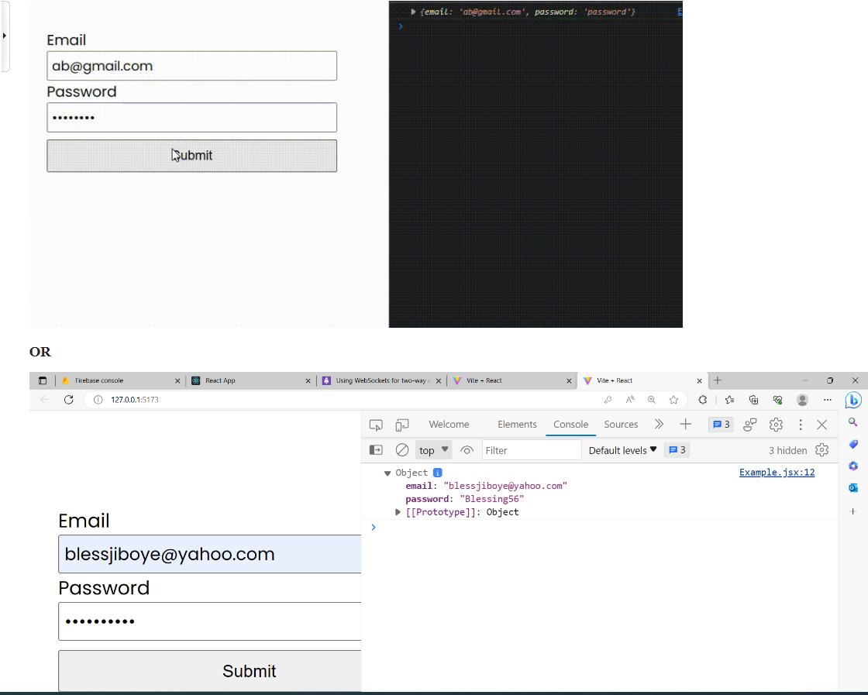
Output
Check the output in the console of your browser window.

Slide 56
Form Validation
React Hook Form makes simple form validation very straightforward by aligning with "browser native validation" attributes. As such, the following basic validation rules are provided:
required: Indicates that the input must have a value before the form can be submitted.
min: The minimum value to accept for this input (number)
max: The maximum value to accept for the input (number)
minLength: The minimum length of the value to accept for the input
maxLength: The maximum length of the value to accept for the input
pattern: The regex pattern for the input.

Slide 57
Adding Validation Rules to "register"​
In addition to "registering" our form controls, the "register" function also accepts a second "options" parameter to configure how the control behaves, including setting validation rules.
For example, we will start with the following simple form:
Follow the word document added/attacheched to the Week8 in your course shell named Form Validation

Slide 58
Updated client/src/counter.jsx
import { useForm } from 'react-hook-form';
import { useEffect } from 'react';
export default function FormWithValidation() {
const { register, handleSubmit, setValue, formState: { errors } } = useForm({
defaultValues: {
firstName: "",
lastName: "",
age: 0
}
});
useEffect(() => {
let data = {
firstName: "Homer",
lastName: "Simpson",
age: 42
}

Slide 59
Updated client/src/counter.jsx contd.
// set the values of each form field to match "data"
for (const prop in data) {
setValue(prop, data[prop]);
}
}, []);
function submitForm(data) {
console.log(data);
}
return (
<form onSubmit={handleSubmit(submitForm)}>
First Name: <br />
<input {...register("firstName", { required: true, maxLength: 20 })} className={errors.firstName && "inputError"}/>
{errors.firstName?.type === "required" && <span><br />First Name is required</span>}
{errors.firstName?.type === "maxLength" && <span><br />First Name Cannot contain more than 20 characters</span>}
<br /><br />
Last Name: <br />
<input {...register("lastName", { pattern: /^[A-Za-z]+$/i })} /><br /><br />
Age: <br />
<input type="number" {...register("age", { min: 18, max: 99, validate: { onlyEven: v => v % 2 == 0 } })} /><br /><br />
<button type="submit" disabled={Object.keys(errors).length > 0}>Update User</button>
</form>
);
}

Slide 60
Updated index.css
Add the following css code at the end of the existing css code.
.inputError{
background-color: red;
}

Slide 61
